Slide 1

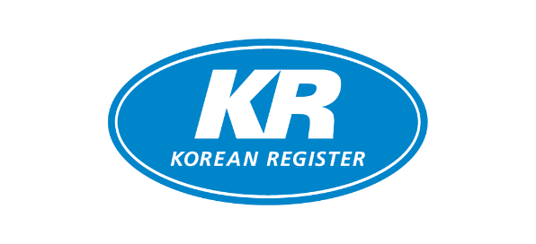
Overview of KR
April 2025
Copyright KR All rights reserved.

Slide 2
Contents
1. General
2. Technical Expertise and Resources
3. Global Coverage and Support Network
4. Risk Management and Safety Standards
5. Value-Added Services
6. Digital Capabilities and Future-Readiness
7. Suggestions for Cooperation

Slide 3
Contents
1. General
2. Technical Expertise and Resources
3. Global Coverage and Support Network
4. Risk Management and Safety Standards
5. Value-Added Services
6. Digital Capabilities and Future-Readiness
7. Suggestions for Cooperation

Slide 4
History
1960~
1970~
1980~
KR is founded in June 1960.
Obtains authority to issue Panama Canal
Tonnage Certificate in November 1968
Obtains authority to issue Suez Canal
Tonnage Certificate in August 1970
Obtains authority to conduct statutory surveys
from Panama Administration in September 1970
Becomes an associate member of IACS in 1975
Fleet size reaches 10 million GT in January 1988
Becomes a member of IACS in May 1988
1990~
2000~
2010~
Listed in the Institute Classification Clause
of London underwriters in January 1990
Accredited as ISO 9000 certification
body in January 1996
Accredited as ISM Code certification
body in July 1997
Recognized by a number of world-class oil majors
including BP, Shell, Exxon Mobil, Total,
Chevron Texaco, StatoilHydro, REPSOL, Petronas,
VELA, Preem, Rightship, ConocoPhillips, Borealis,
Neste Oil, INEOS, LUKOIL and TESORO.
IACS Chairmanship
Ranked No.1 among IACS members by Korea
Shipbuilder’s Association (KOSHIPA) in the
evaluation of the performance of class societies.
Authorized as verification body for EU MRV
Fleet size reaches 80 million GT in 2022

Slide 5
Organization Chart
General Assembly
Board of Directors
Chairman/CEO
Class Committee
Technical Committee
Audit Office
External
Affairs
Strategic Planning
Survey
Admin.
Statutory
Technical
R&D
Business
47 Teams & 73 Offices
Notes:
Established and operated as Non profit organization

Slide 6
Status of Authorisation (80 countries)
 | Flag |  | Flag |  | Flag |  | Flag
1 | Algeria | 22 | Fiji | 43 | Luxemburg | 64 | San Marino
2 | Antigua and Barbuda | 23 | France | 44 | Malaysia | 65 | Senegal
3 | Argentina | 24 | Gabon | 45 | Maldives | 66 | Serbia
4 | Australia | 25 | Georgia | 46 | Malta | 67 | Sierra Leone
5 | Azerbaijan | 26 | Germany | 47 | Marshall Islands | 68 | Singapore
6 | Bahamas | 27 | Ghana | 48 | Mauritius | 69 | South Africa
7 | Bahrain | 28 | Greece | 49 | Moldova | 70 | Spain
8 | Bangladesh | 29 | Honduras | 50 | Mongolia | 71 | Sri Lanka
9 | Barbados | 30 | Hong Kong | 51 | Myanmar | 72 | St. Kitts & Nevis
10 | Belize | 31 | India | 52 | Nauru | 73 | St. Vincent
11 | Bolivia | 32 | Israel | 53 | Niue | 74 | Thailand
12 | Brunei | 33 | Iran | 54 | Oman | 75 | Togo
13 | Cabo Verde | 34 | Iraq | 55 | Pakistan | 76 | Türkiye
14 | Canada | 35 | Jamaica | 56 | Palau | 77 | Tuvalu
15 | Comoros Islands | 36 | Jordan | 57 | Panama | 78 | U.A.E.
16 | Cook Islands | 37 | Kenya | 58 | Papua New Guinea | 79 | Vanuatu
17 | Cyprus | 38 | Kiribati | 59 | Philippines | 80 | Vietnam
18 | Denmark | 39 | Latvia | 60 | Portugal (Madeira) | 81 | -
19 | Commonwealth of Dominica | 40 | Libya | 61 | Qatar | 82 | -
20 | Equatorial Guinea | 41 | Lebanon | 62 | Republic of Korea | 83 | -
21 | Faroe Islands | 42 | Liberia | 63 | Romania | 84 | -
Notes:
If you have a look at our authorization status, we are currently authorized by 80 governments including Greece to provide statutory services.

Slide 7
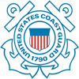


PSC Performances
 | 2021 | 2022 | 2023 | 2021 | 2022 | 2023 | 2021 | 2022 | 2023
No. of inspections | 2,037 | 2,254 | 2,737 | 513 | 674 | 667 | 428 | 387 | 381
No. of class-related detention | 4 | 4 | 6 | 2 | 1 | 1 | 0 | 0 | 0
Detention Ratio | 0.19% | 0.18% | 0.21% | 0.39% | 0.15% | 0.14% | 0.00% | 0.00% | 0.00%
- Tokyo MOU : White List (3-year rolling average rate)
- Paris MOU : White List (3-year rolling average rate)
- USCG : Priority I / Top rank (3-year rolling average rate)

Slide 8


Fleet Status
Total : 3,153 Vessels / 88.1 m.GT
Ship Type
As of Dec. 2024
Others 4.6 m.GT
491
750
Gas 8.4 m.GT
Bulk Carrier
Tanker
RoRo & PCTC 7.2 m.GT
330
155
Bulk Carrier 29.0 m.GT
G/T
Container
RoRo & PCTC
Container 15.0 m.GT
178
1249
Gas
Others
Tanker 23.9 m.GT

Slide 9
International Shipowners
Top 20 International Shipowners together with KR
359
KR International Shipowners
926 Ships / 25.7 m.GT
Ship Owner
RANK. | Company Name | Nationality | Main Ship Type | Ship(s) | GT
1 | Wallenius Wilhelmsen | Norway | PCTC | 29 | 1,832,865
2 | PCT GROUP | VIETNAM | Gas Carrier Tanker | 40 | 1,602,503
3 | DALIAN LONGBO | China | Tanker | 13 | 1,352,450
4 | DANAOS SHIPPING CO., LTD | Greece | CNTR | 13 | 769,641
5 | NSC SHIPPING GmbH & Cie. KG | Germany | CNTR | 8 | 618,983
6 | International Seaways, Inc. | USA | Tanker | 14 | 411,198
7 | NIRIIS Shipping S.A. | Greece | Bulk Carrier | 10 | 401,071
8 | Bright Navigation | Greece | Bulk Carrier | 6 | 396,239
9 | Oceonix Services Ltd | UK | Bulker, Tanker | 4 | 369,742
10 | Navig8 Group | Singapore | Tanker | 12 | 361,214
RANK. | Company Name | Nationality | Major Ship Type | Ship(s) | GT
11 | Ray Car Carriers | Israel | PCTC | 6 | 345,852
12 | Bernhard Schulte GmbH & Co. KG | Germany | CNTR | 7 | 340,016
13 | Arne Blystad AS | Norway | Tanker | 25 | 334,957
14 | Maran Tankers Management | Greece | Tanker | 2 | 324,660
15 | Greetee Co Ltd | China | Tanker | 2 | 320,322
16 | Nippon Yusen Kaisha (NYK) | Japan | Bulk Carrier | 6 | 303,123
17 | Winning International | China | Bulk Carrier | 4 | 276,203
18 | Unity Group | UK | Bulk carrier | 8 | 273,772
19 | LILA GLOBAL | UAE | Bulk Carrier | 8 | 256,480
20 | Santoku Shipping | Japan | Bulk carrier | 6 | 240,714
Notes:
We have various international shipowners as our clients and this table shows the top 20 valuable international shipowners who are together with KR.

Slide 10
Contents
1. General
2. Technical Expertise and Resources
3. Global Coverage and Support Network
4. Risk Management and Safety Standards
5. Value-Added Services
6. Digital Capabilities and Future-Readiness
7. Suggestions for Cooperation

Slide 11
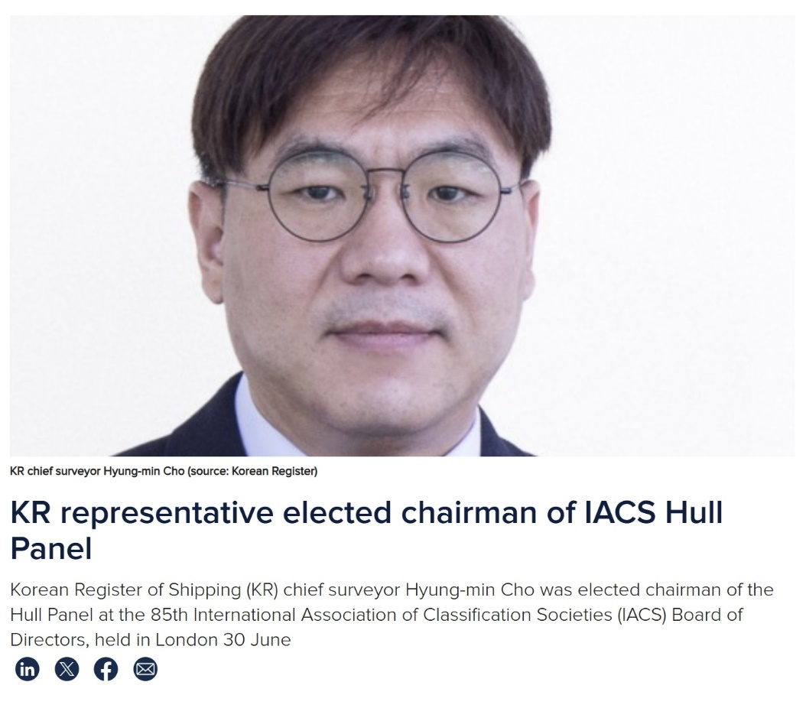
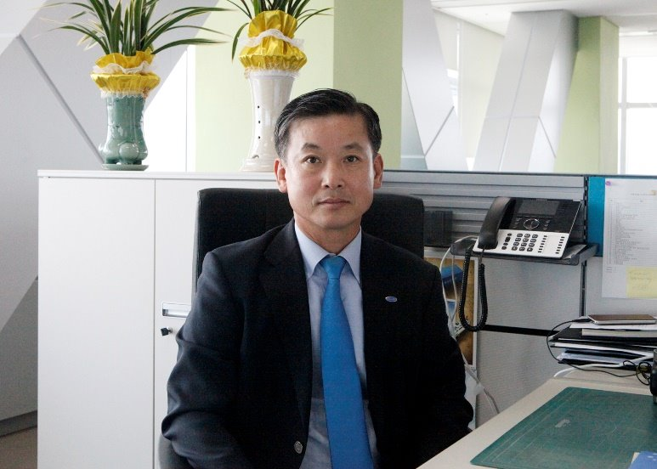
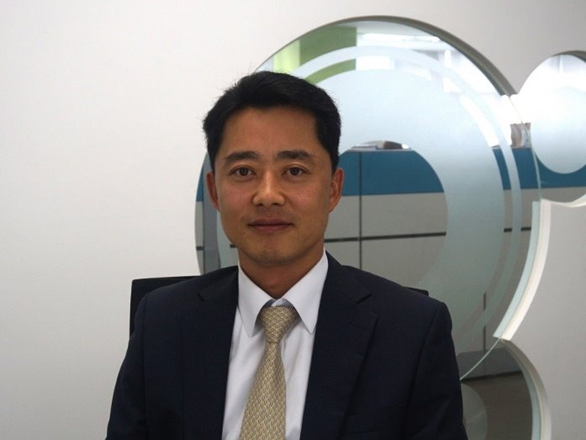

Technical Expertise
IACS Hull Panel Chairmanship (As of now)
IACS Chairmanships in the past
IACS Machinery Panel Chairman
IACS Environment Panel Chairman
Notes:
There are several issues under discussion during IACS Hull panel meetings including the revision in IACS Rec.34 Rev.2 being used for the revision to the CSR, taking into account the new wave data in the North Atlantic area, as well as an increase in extreme weather conditions as per the concerns raised by the industry.
As IACS Hull panel chairman, hull panel member as well as PT member for the Consequence Assessment of new CSR application in order to develop the new CSR, experts in KR try to contribute to set up new Rule which will address the industry concerns without compromising on the structural safety of the ships including tankers against the latest new wave loads.
Also there is one PT led by KR expert under IACS EG/MW(Material and Welding) in order to develop new IACS recommendation which will establish an unified approach for ECA(Engineering Critical Assessment). And the intention of this PT is to ensure sufficiently safe design of type C independent tanks for ships carrying liquefied gases in bulk and ships using gases or other low-flashpoint fuels.

Slide 12









Group of Experts in Maritime Industry
150 non-Koreans work in harmony for safer shipping
Myron Kornaros, KR Europe
Michael Suhr, KR North Europe
B. Thanabalasingam, KR Asia-Pacific
Darnell C. Baldinelli, KR Seattle
Philip Nielsen, KR Hamburg
Nithi Baskaran, KR Singapore
Li Zheghao, KR China
Yavuz Surucu, KR Istanbul
Michael Nii Oblija Tetteyfio, KR Acra

Slide 13






Technical Expertise
Active exchange of technical opinion with stakeholders
TSCF
Class member
SIGTTO
Associate member
BIMCO
Associate member
INTERTANKO
Associate member
INTERCARGO
Associate member
IMO
Korean delegation
Notes:
Working with International maritime stakeholders,

Slide 14
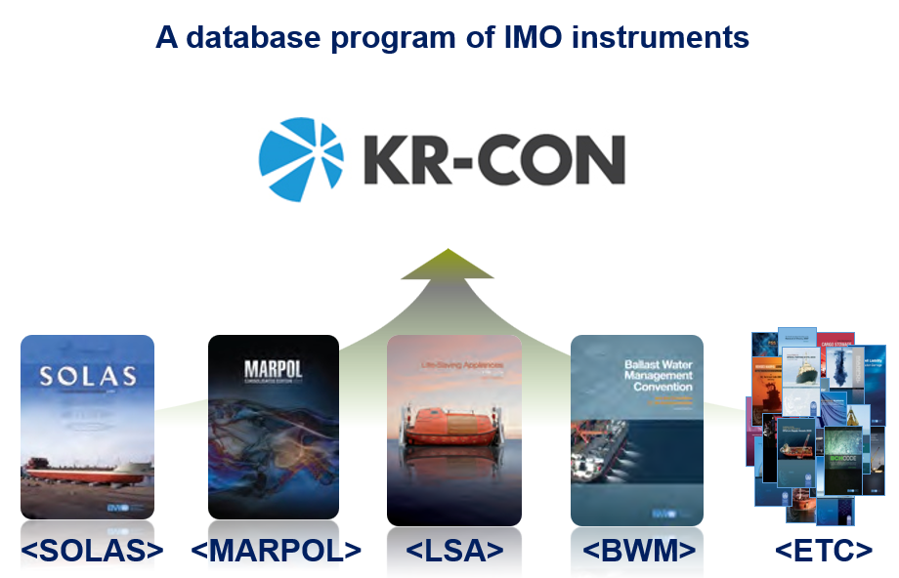
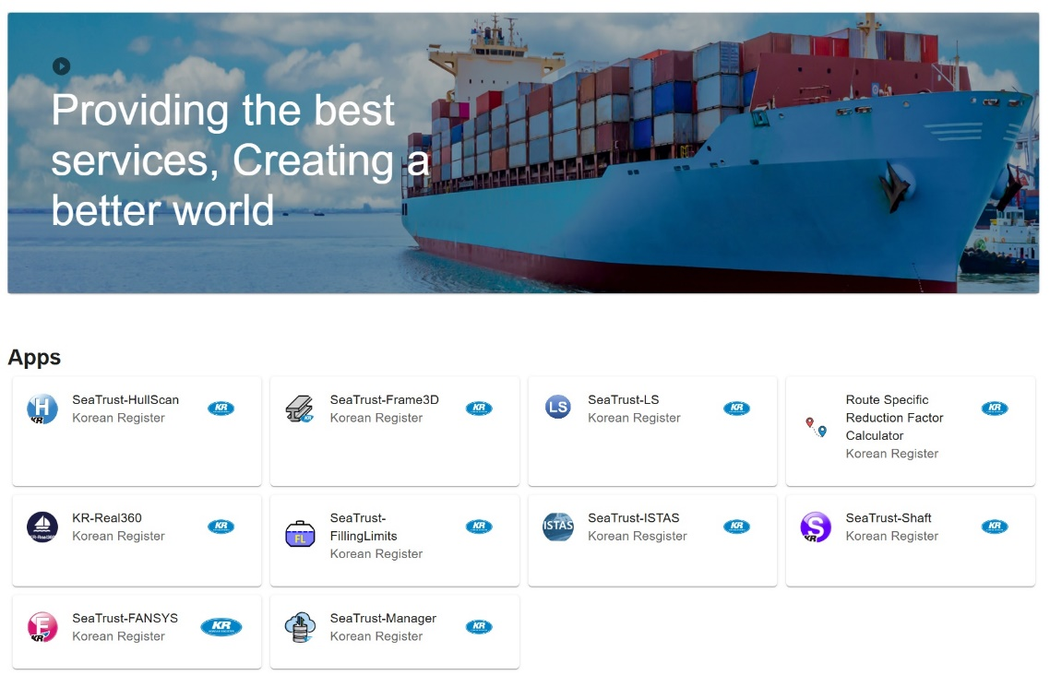
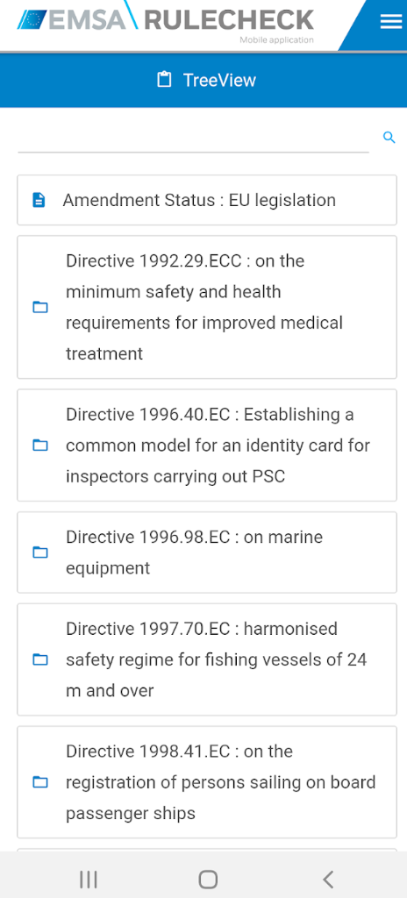
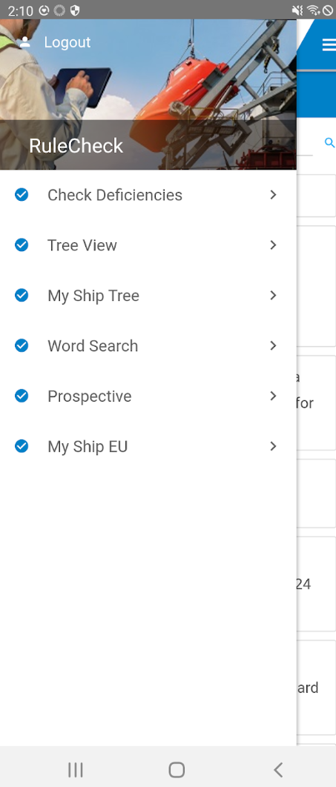
Maritime Industry Software developed by KR
Sea-Trust Series Software
KR-CON Software
EMSA RuleCheck Software
Notes:
KR always would like to contribute to the international maritime industry using our accumulated knowledges in order to ensure the safety of the ships and prevention of pollution while in compliance with national and international regulations.

Slide 15
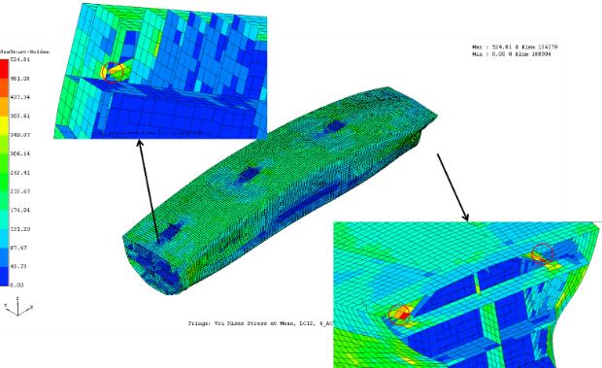
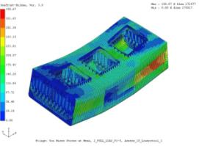
KR Structural Safety Assessment Programs
SeaTrust
HullScan
Section Creation
Rule Scantling for CSR and non-CSR
Direct Strength Assessment
Mesh Modeling
Buckling Assessment
Interface, including 3D CAD software (NAPA, AVENA, S3D)
ISTAS
Integrated Structural Analysis
System for Global Ship Structure
FANSYS
Fatigue Assessment System
679 users of Sea-Trust HullScan Program including most of shipyards and designers in Korea
Notes:
NAPA Steel, AVENA Marine

Slide 16
Contents
1. General
2. Technical Expertise and Resources
3. Global Coverage and Support Network
4. Risk Management and Safety Standards
5. Value-Added Services
6. Digital Capabilities and Future-Readiness
7. Suggestions for Cooperation

Slide 17
Survey Network
HELSINKI
Antwerp
COPENHAGEN
ST. PETERSBURG
North Europe
GDANSK
HAMBURG
LONDON
ROTTERDAM
VANCOUVER
OSAKA (南)
America
PARIS
MILANO
ATHENS
QINGDAO
NEW YORK
Europe
DALIAN
TOKYO
NAGOYA
SEATTLE
LISBON
FRANKFURT
ISTANBUL
OSAKA (北）
MADRID
ALEXANDRIA
China
KOREA
IMABARI
LOS ANGELES
HOUSTON
SHANGHAI
FUKUOKA
NEW ORLEANS
MUMBAI
NINGBO
TAIPEI
DUBAI
GUANGZHOU
NANJING
HO CHI MINH
CHENNAI
HONGKONG
MANILA
ACCRA
PANAMA
NATRANG
KUALA LUMPUR
BANGKOK
JOHOR BAHRU
JAKARTA
SINGAPORE
Asia-Pacific
BRISBANE
SAO PAULO
CAPE TOWN
SYDNEY
SANTIAGO
BUENOS AIRES
PERTH
73 survey stations in 38 countries
1 Head Office and 5 Regional Offices
24/7 services
Country | Number of Offices
Korea | 15
Outside Korea | 58
Total | 73
Notes:
6 survey stations in China, 15 in Korea

Slide 18
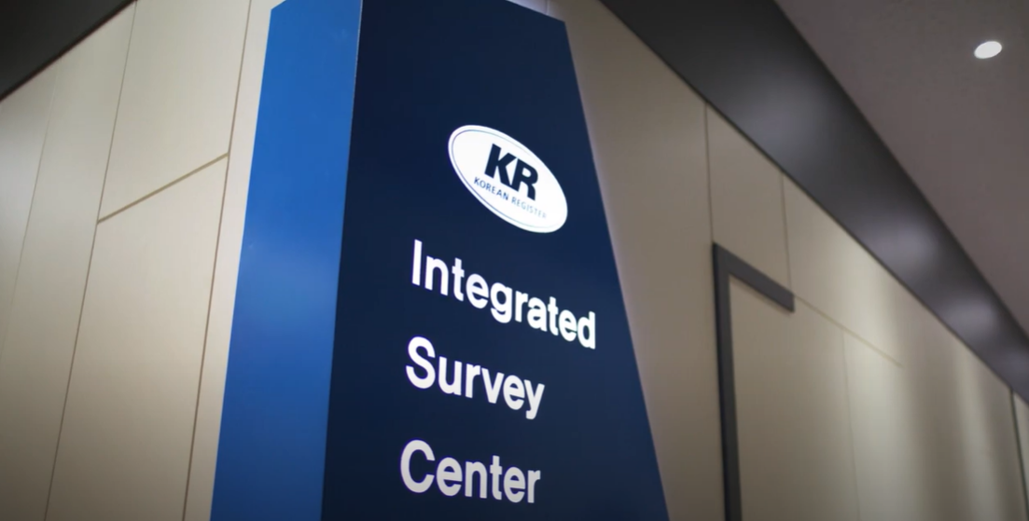
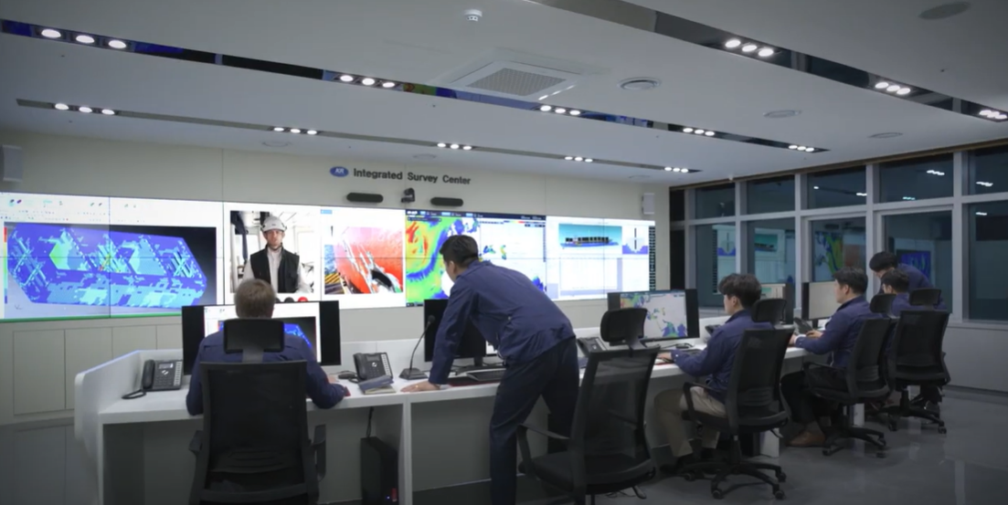
Remote Survey and Support
KR Integrated Survey Center (ISC)
  ISC opened and operated in May 2022
  KR – ISC offers
  - Remote survey and support
  - Monitoring of CII rating for KR’s fleet
  - Ship’s information and weather condition
  - Ship’s survey report and drawings
  - Ship’s stability and structural strength
  - Monitoring of KR’s fleet and PSC response
Notes:
KR Integrated Survey Centre opened in May 2022.
And this ISC can offer:
- Remote survey and support
- Ship’s information and weather condition
- Ship’s survey report and drawings
- Ship’s stability and structural strength
- Monitoring of KR’s fleet and PSC response
- Monitoring of CII rating for KR’s fleet
원격검사/지원, 선박정보/기상정보, 검사보고서/도면, 선박 구조강도/복원성, CII 모니터링 등을 할 수 있음

Slide 19
Contents
1. General
2. Technical Expertise and Resources
3. Global Coverage and Support Network
4. Risk Management and Safety Standards
5. Value-Added Services
6. Digital Capabilities and Future-Readiness
7. Suggestions for Cooperation

Slide 20
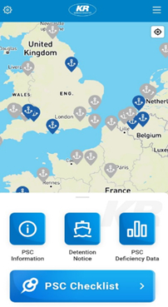
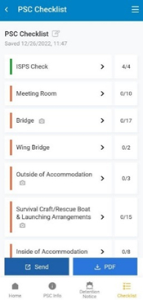
KR Port State Control (PSC) Service
Mobile Application for PSC
KR launched ‘KR PSC ADVISER’, mobile app to help clients prepare for PSC inspections in order to reduce the risk of PSC detentions by providing the latest PSC information in real-time and allowing seafarers to easily keep abreast of PSC checklists with a single app.
User-friendly interface by allowing users to check major PSC deficiencies in each region, port by port with the world map displayed as the main screen
Notes:
KR PSC ADVISER를 개발하여 항만국통제관련 정보를 실시간으로 지역별로 제공가능하며 또한 선박의 각 구역별 확인사항을 보기쉽게 체크리스트 형식으로 제공하여 고객의 출항정지 방지에 도움을 주고 있습니다.
Aiming to prevent maritime accidents and protect the marine environment, a PSC inspection is the regulatory procedure that ensures foreign ships and their equipment entering national ports comply with international conventions.
Currently, over 150 countries around the world are systematically implementing the procedure, so shipowners and operators entering foreign ports need to be well-prepared for inspection.
As part of its commitment to help its customers prepare for PSC inspections, KR regularly hosts PSC seminars and provides customers with PSC information on its website and official documents. With the launch of this new app, KR expects its PSC services to be more accessible to its customers.
The newly released KR PSC ADVISER maximizes user convenience by displaying the world map as the main screen, allowing users to check the major PSC deficiencies in each region, port by port. Users can search for each deficiency with a keyword by using its Word Search function.
By informing users of the three most frequent deficiencies at each port, the app helps users avoid being detained by the PSC.
KR PSC ADVISER mobile app is available for both iOS and Android devices and can be downloaded from Google Play and the App Store.

Slide 21
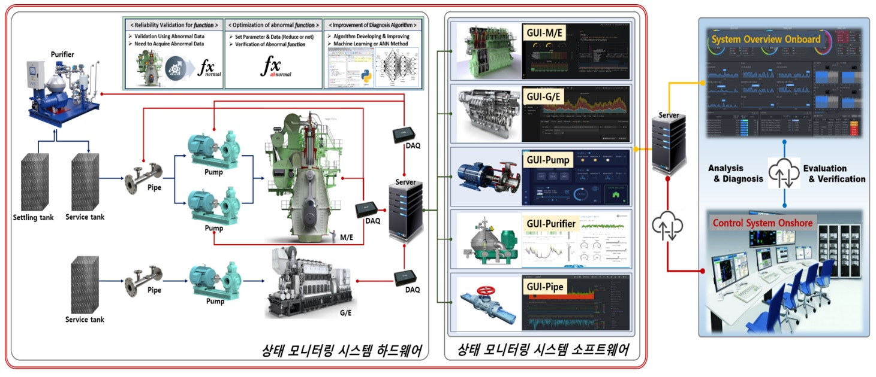
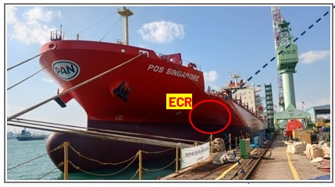
CBM(Condition Based Maintenance)
CBM
Approved condition monitoring(CM) system is fitted, credit for survey may be based on acceptable condition monitoring results [KR Rule Part I, Annex 1-8. 3]
Concept of Condition Monitoring System
Empirical Test on Real Ship in Progress

Slide 22
Contents
1. General
2. Technical Expertise and Resources
3. Global Coverage and Support Network
4. Risk Management and Safety Standards
5. Value-Added Services
6. Digital Capabilities and Future-Readiness
7. Suggestions for Cooperation

Slide 23
Value-Added Services for New Building Projects
Specific request from the Owner
High payload at a US river draft
Taking advantage of the New Panama Canal
Larger cargo hold volume
Enhanced versatile cargo system allowing homogenous or multi-grade cargoes (max 7 grades)
Slow steaming capability (10-12.5 kts) with significantly reduced bunker consumption
Compliance with the EEDI requirements
Notes:
선주사의 아이디어를 KR의 설계화 시킨 예

Slide 24
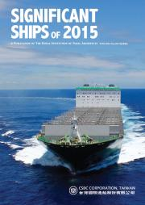
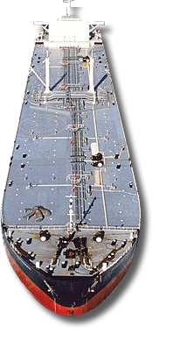
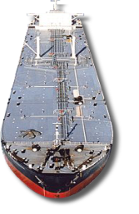
Technical Advisor For Concept to Reality
‘Significant Ships of 2015’
by Royal Institution of Naval Architects UK
M/T Navig8 Excel (74K LR 1 Tanker) built by STX SYD
From concept to Reality
219m
Benefits of New Concept Design
4.7% Cargo hold volume
Payload
4.5% Fuel use
15.4%
32.24
40m
Notes:
KR has been working closely with a Singapore based shipowner to develop the concept of building a wide beam 74K LR1 tanker capable of taking advantage of the soon-to-be widened Panama Canal.
The owner’s new concept LR1 tanker was to have a similar port accessibility as a standard MR1 tanker, carry as much cargo as possible, be suitably equipped to carry light specific gravity cargo and be optimized for fuel efficiency.
Working with the owner, KR conducted a thorough review of this new concept and conduct a feasibility study and KR demonstrated that the concept could be used to develop a new vessel type.
With this new design, the owner could obtain
High payload at river draft
Larger cargo hold capacity
Enhanced cargo system flexibility allowing homogeneous or multi-grade cargoes maximum 7 grades
Slow steaming capability with significantly reduced bunker consumption
Compliance with EEDI requirements
And Royal Institution of Naval Architects UK awarded the design co-developed by KR as Significant Ships of 2015 this year.

Slide 25
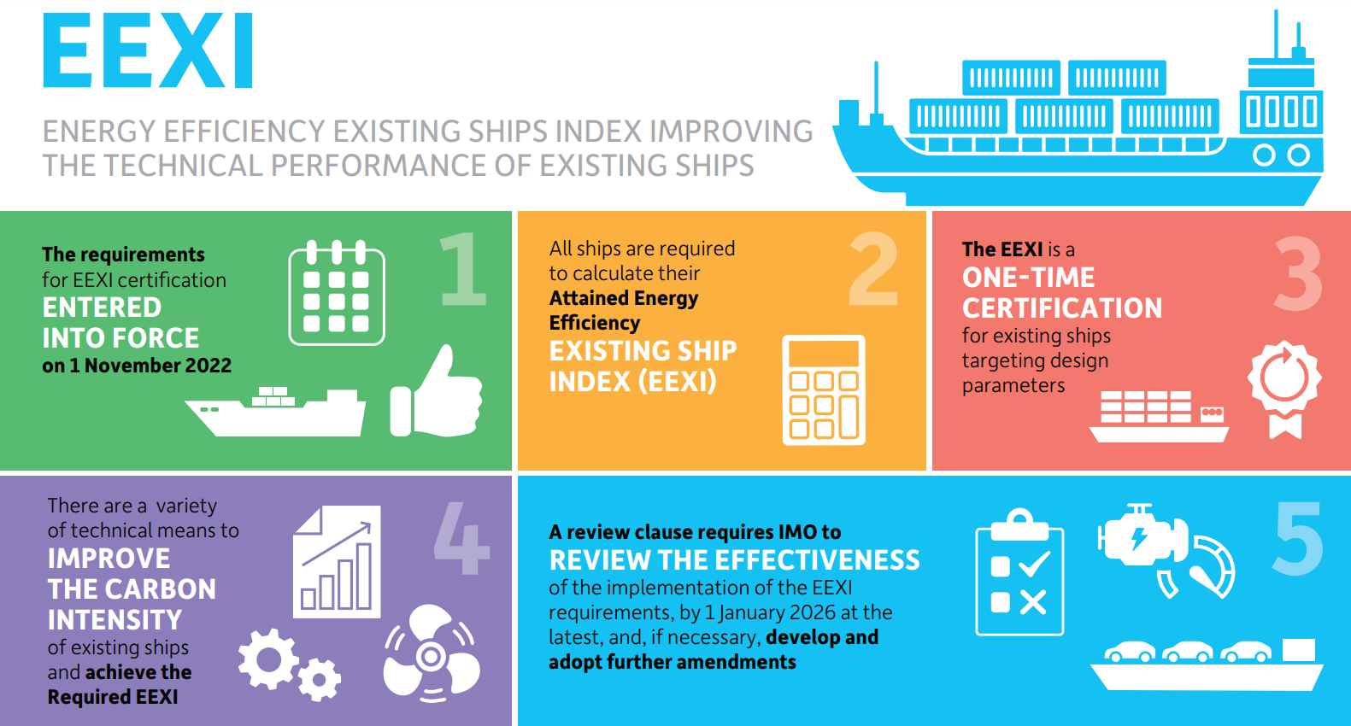
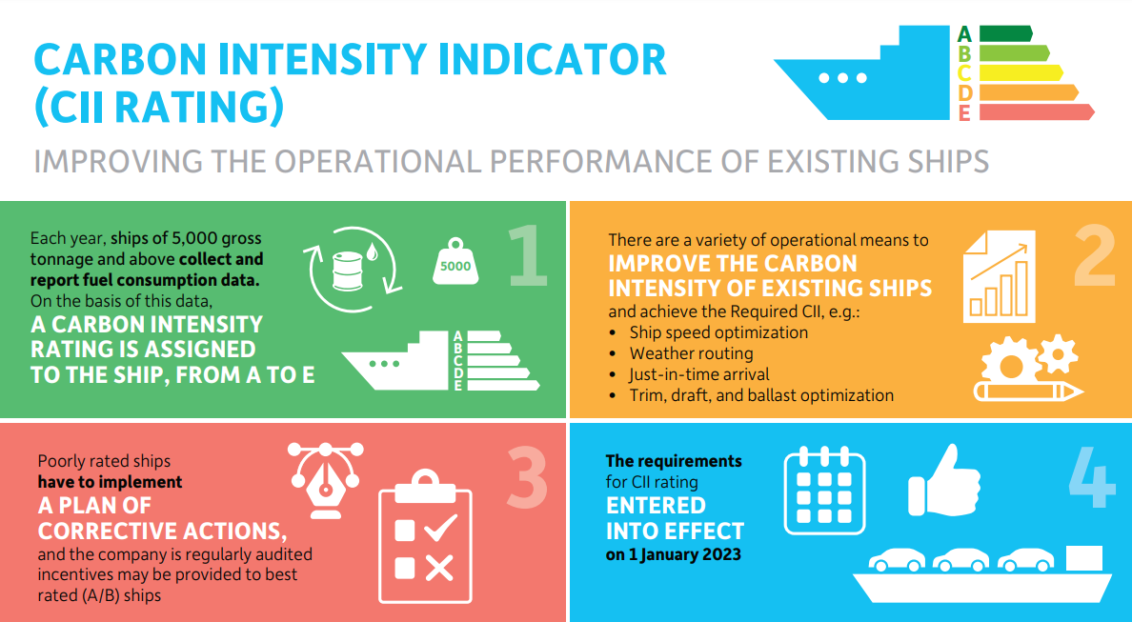
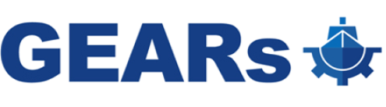
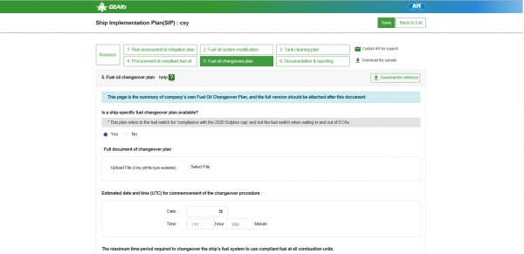
Value-Added Services for Ships in Service
  KR provide bespoke EEXI/CII solutions for sustainable and greener shipping and tailored EU fit for 55 solution.
GHG Emission, Authentic Reporting System
Efficient management of fleet GHG emission data
Robust foundation for analyzing and optimizing
ship operational efficiency

Slide 26

Value-Added Services for Ships in Service
Operational Efficiency Optimization
１．Fleet GHG Emission
ー GHG Emission Analysis
ー CII Calculation & Grade Forecast
ー Expected Penalty Cost
２．Suggestions for Measures
ー Measures to be taken in consideration of ship’s routes
ー Best ship routing for CO2 reduction
ー Economic Assessment of Measures
３．Bespoke Decarbonization Strategy Proposal
HYUNDAI GLOVIS

Slide 27
Contents
1. General
2. Technical Expertise and Resources
3. Global Coverage and Support Network
4. Risk Management and Safety Standards
5. Value-Added Services
6. Digital Capabilities and Future-Readiness
7. Suggestions for Cooperation

Slide 28
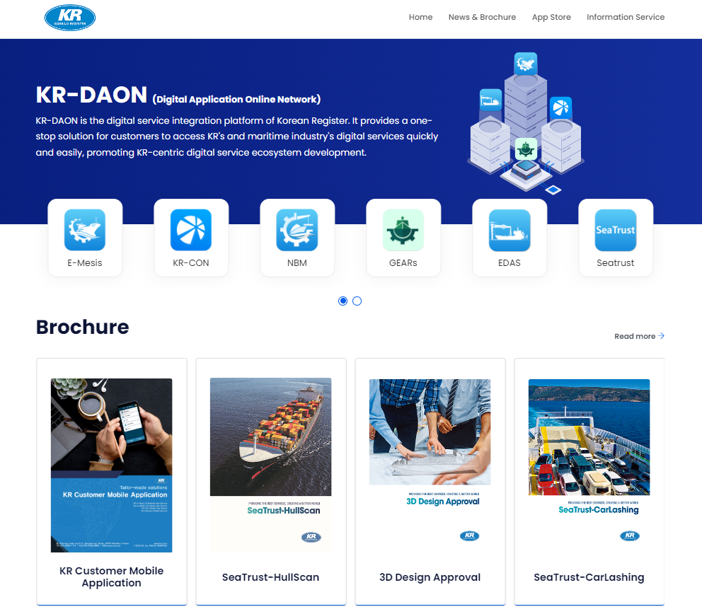
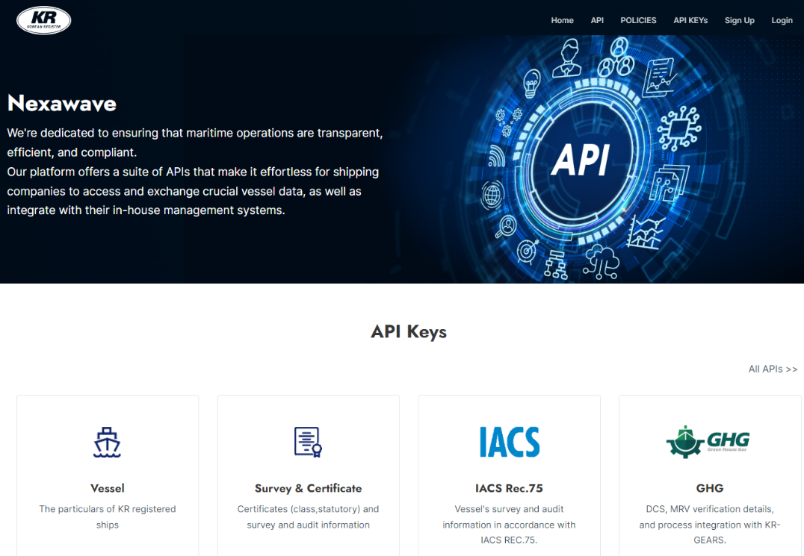
Digitalisation
KR-DAON
Nexawave
Integrated digital platform for KR’s digital services
One-stop hub for all of KR’s digital services
  KR E-Fleet
  KR GEARs
  E-MESIS
  KR-CON
  New Building Master (NBM)
Data exchange platform between clients and KR
Help clients access / collect data from KR
  Survey/Audit information
  GHG verification information
  Vessel information
Notes:
Nexawave is a data exchange platform between KR and our customers(API, Application Programming Interface).
This could help our clients collect data from KR such as survey/audit information, GHG verification information, etc.
KR is providing comprehensive digital solutions to the maritime industries and we recently launched two digital platforms, KR-DAON and Nexawave.
KR-DAON: Digital Application Online Network
KR-DAON is an integrated digital platform for KR’s digital services that include:
So, it is a one-stop solution for customers to access KR’s digital services.
KR E-Fleet: Vessel’s survey/audit status and PSC guidance with KR360(XR based training software)
KR GEARs: GHG verification platform
E-Mesis: Material & equipment inspection
KR-CON: Database for IMO conventions etc.
SeaTrust: Ship design software
NBM: Newbuilding status showing platform (insp’ items/comments/drawings etc.)
EDAS: Electronic plan approval system

Slide 29
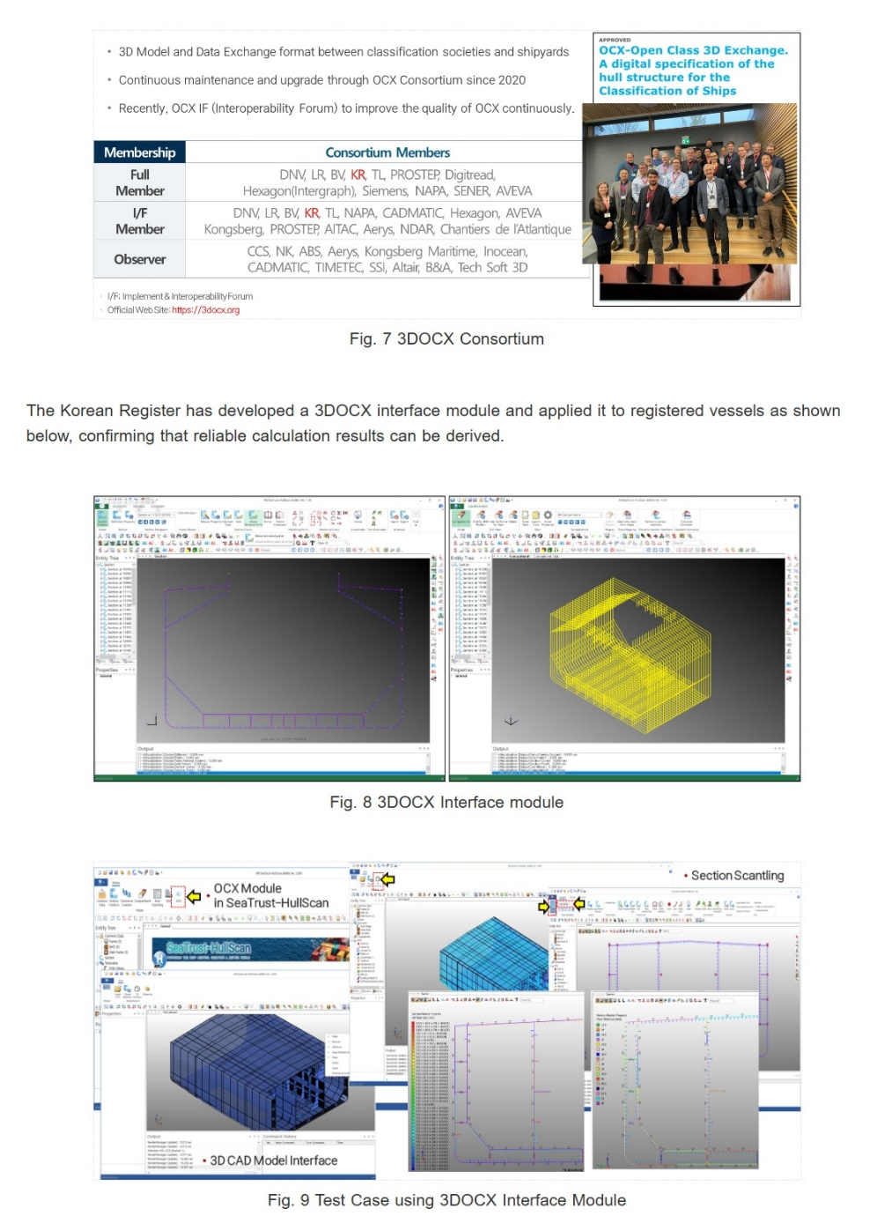
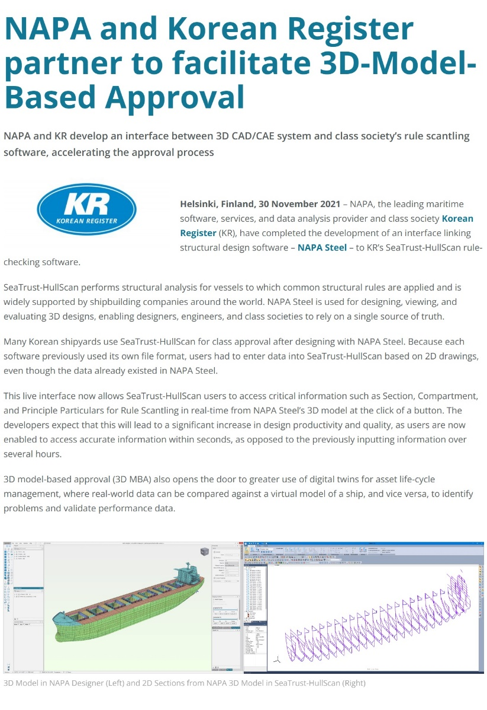
Digitalization in Shipbuilding
3D Model-based Drawing Approval

Slide 30
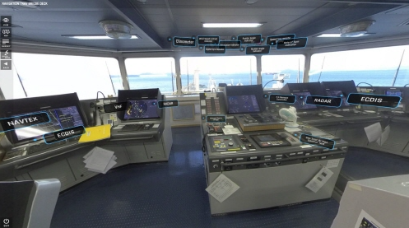
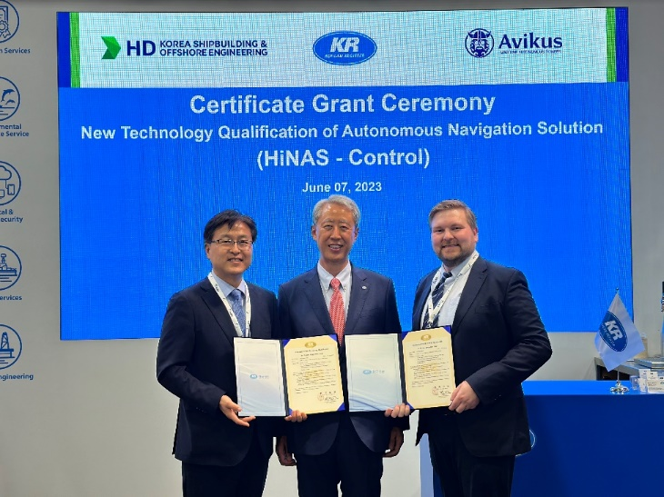
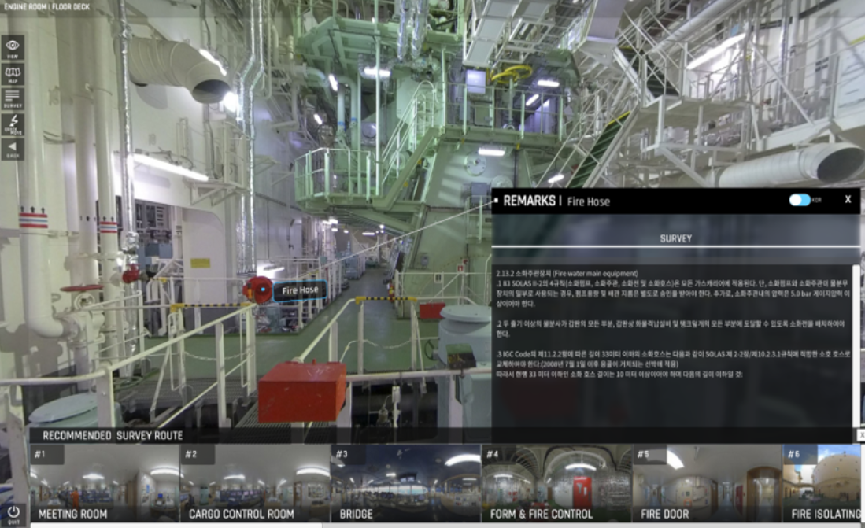
Digitalization in Shipping
KR-Real360
New Technology Qualification for HiNAS
KR awarded NTQ of Autonomous Navigation Solution for Hyundai Intelligent Navigation Assistant System(HiNAS)
KR has confirmed the system’s safety and feasibility according to KR Rules, domestic & international standards, and confirm the system through technical verification using the virtual test drive system at HD KSOE’s Digital Convergence Centre.
Extended Reality-based ship familiarisation/education tool
Collaboration project between HD Hyundai’s digital twin solution, HiDTS, with KR-Real360
Notes:
[KR Real360]
KR developed and launched an extended reality based training software called “KR-Real360”.
With this software, users can easily access anywhere in the ship and find out their detailed information and regulations.
HD Hyundai and KR have agreed to develop a ship education and training program based on extended reality. So both parties are collaborating by integrating HD Hyundai’s digital twin solution, HiDTS, with KR’s ship familiarization education and training platform, KR-Real 360.
현재. 몇몇 선사 신조 발주시 KR-Real360을 제공하는 서비스를 시범적으로 수행했습니다.
선사에서 사용 시, 계약 완료 후, 선박 촬영 -> XR 구축 -> 라이센스 발급 -> 프로그램 설치/사용 하시면 됩니다.
HD현대와는,
HD 한국조선해양에 KR의 서버를 설치하여 자체 운영중에 있고,
HD그룹사(현중, 삼호 등)는 이 플랫폼을 공통으로 사용하기 위해 협의중입니다. (비용/유지보수 방안 등)
이를 위해 금일 오후2시에 HD 한국조선해양 GRC방문 회의 예정입니다.
XR이라고 해서 HMD(Head Mount Display)를 착용하고 해야하는것은 아니고, 다음 로드뷰와 같은 360도 VR을 제공하여 데스크탑, 모니터에서 검사, 매뉴얼 등의 정보를 제공하는 개념입니다.
[HiNAS]
Digitalisation관련 KR 활동 현황에 대해 설명. 마이크로소프트와 협약을 맺고 관련 소프트웨어를 사용하여 디지털 업무환경 조성을 하고 있으며, 또한, 현대중공업 자회사인 Avikus에서 개발한 HiNAS라는 항해보조시스템을 승인하여 실제 입급선박에서 사용하고 있습니다.
As far as the Digitalisation is concerned, we are cooperating with Microsoft for Digital Transformation and we have awarded New Technology Qualification for HiNAS, a navigation-aid programme for autonomous ships.
Very FIRST navigation aid system, which was installed on a merchant vessel, SEA SHANGHAI(VLOC), operated by PAN OCEAN. It helps safe navigation and improvement of energy efficiency of ships (by finding optimal navigation routes). Approved by Korea and Panama, tested for the route of Singapore – China. Soon to be tested for the route up to Brazil.
HiNAS 2.0 –
The commercialization of autonomous shipping has taken another step forward with Korean Register (KR), Avikus and HD Korea Shipbuilding & Offshore Engineering (HD KSOE) awarding New Technology Qualification (NTQ) on
7 June during Nor-Shipping 2023 for Hyundai Intelligent Navigation Assistant System (HiNAS Control).
“HiNAS Control”, developed by Avikus, a subsidiary of Hyundai Heavy Industries (HHI), and HD Korea Shipbuilding
& Offshore Engineering (HD KSOE), use augmented reality (AR) to enable a ship to navigate optimal routes, at ideal speed, and avoid collisions based on the integrated data by artificial intelligence (AI) collected from sensors attached to a vessel and its sailing equipment.
The solution was developed to ensure safe navigation, improve fuel efficiency and ease the operational burden on bridge teams. The autonomous system is expected to also reduce maritime accidents and air pollutants.
The NTQ was conducted in accordance with the "Guidelines for New Technology Qualification" established by KR to evaluate new
maritime technology. The NTQ process comprises four stages: feasibility and concept verification, prototype validation, system
integration, and operational assessment. KR's comprehensive review of classification rules and international regulations confirmed
the outstanding performance of HiNAS Control. Through rigorous risk assessment and technical evaluation, KR issued an NTQ
statement for this groundbreaking autonomous navigation system.
The successful completion of the System Integration Stage, the third stage of the NTQ process,
solidifies HiNAS Control's capabilities as an innovative AI-based autonomous navigation system.
With the issuance of the NTQ statement for HiNAS Control, KR reinforces its commitment to fostering innovative maritime
technologies that drive the industry forward and ensure a safer and greener future.

Slide 31
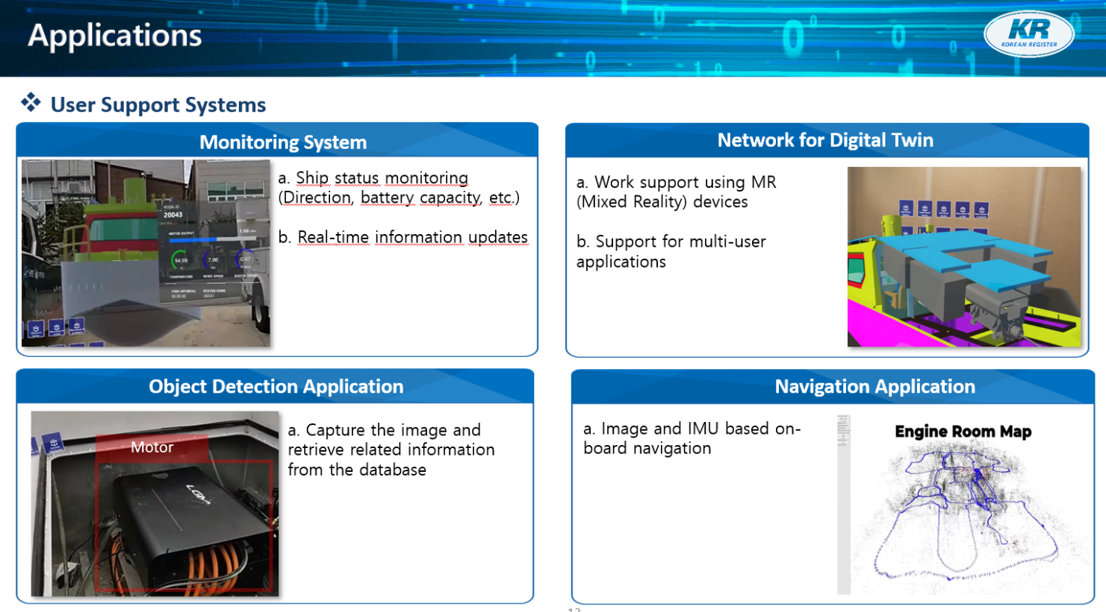
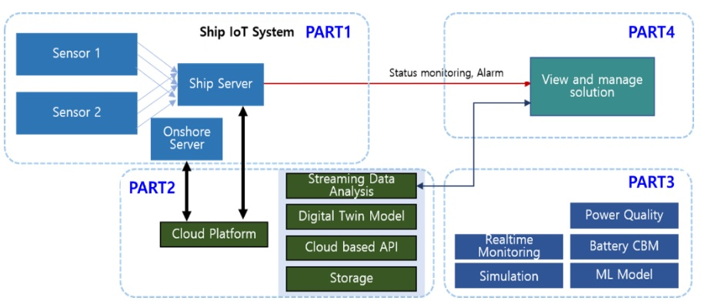
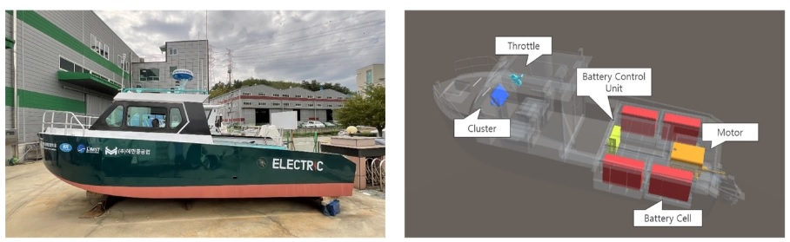
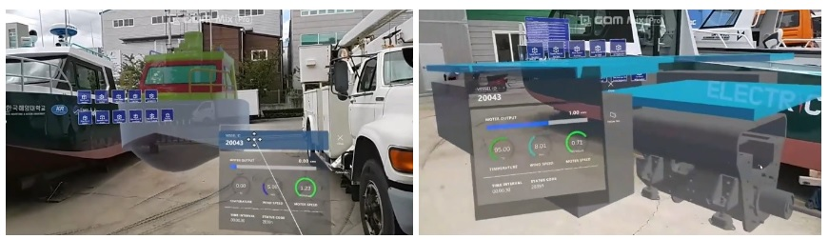
Digitalization in Shipping
Digital Twin
Digital Twin Architecture
3D Model using MR Digital Twin System
Mixed Reality based Application of Digital Twin Monitoring System

Slide 32
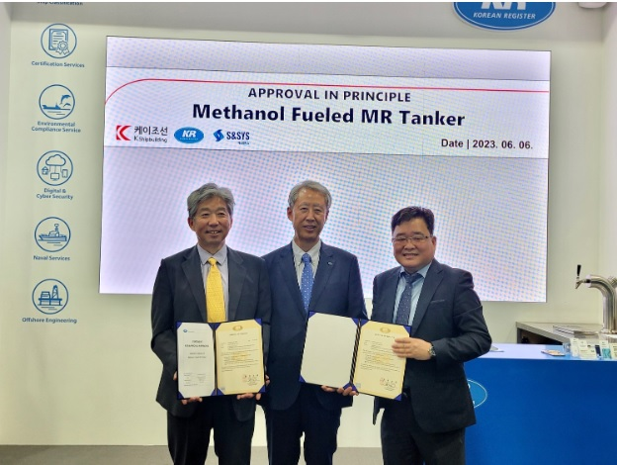
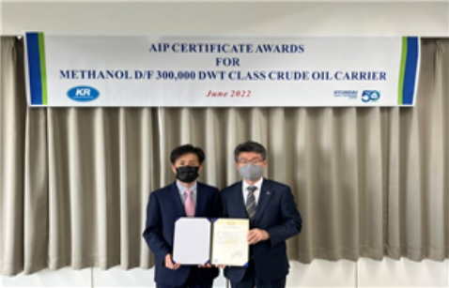
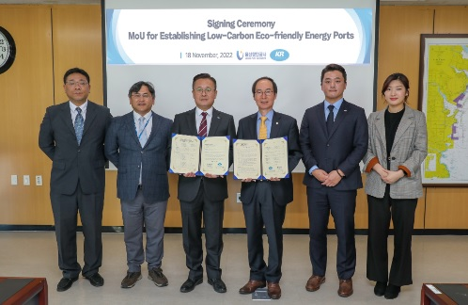
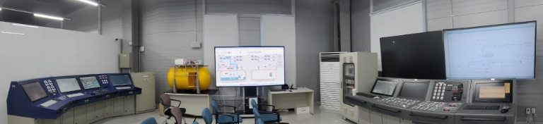
De-carbonization
AIP for Methanol Fueled MR Tanker
AIP for Methanol Fueled VLCC with HD Hyundai HI
MoU for Methanol Bunkering in Ulsan
Methanol Bunkering Simulation System

Slide 33
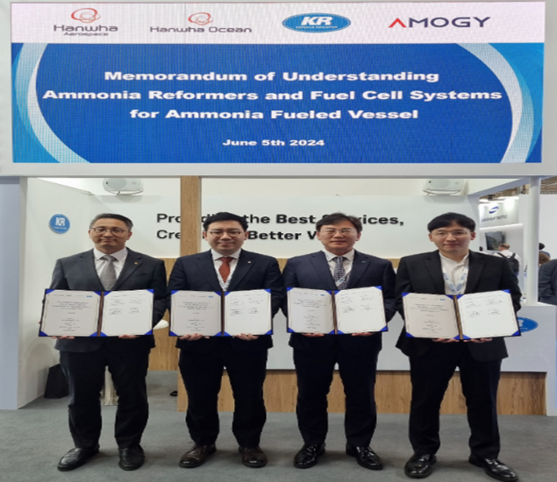
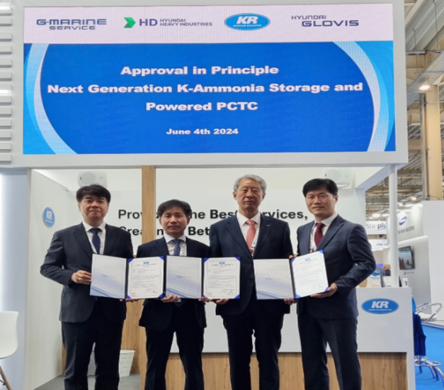
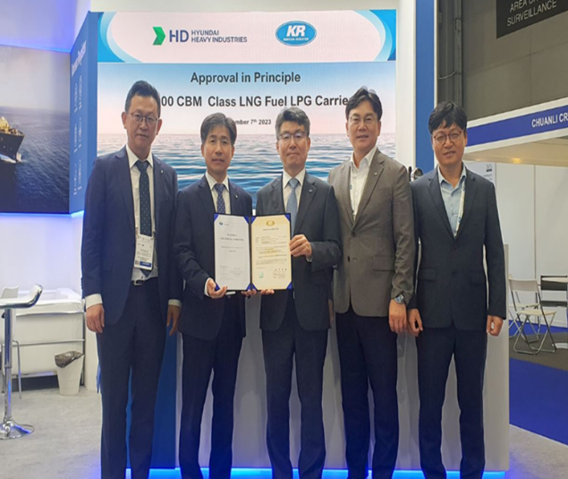
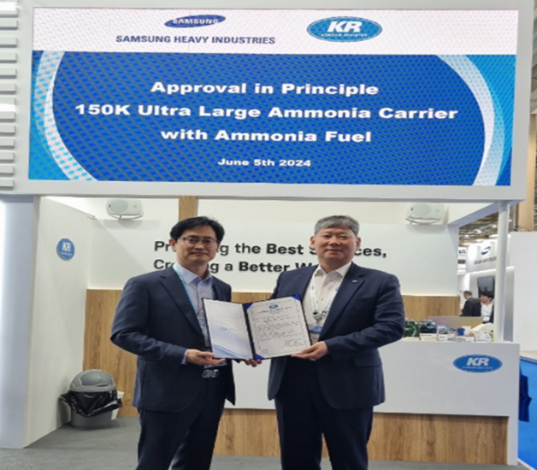
De-carbonization
Ammonia Reformers & Fuel Cell Systems
AIP for K-Ammonia Storage & Powered PCTC
AIP for LNG Dual-Fueled VLGC
AIP 150K CBM ULAC
Notes:
As part of our decarbonization activities, we have been continuously collaborating with lots of world leading shipyards for such as:
Ammonia reformers & fuel cell systems
Ammonia storage & powered pctcs
LNG dual fueled VLGCs
150k ULACs
Also, the world’s first ammonia engine was type approved by KR earlier this month at HHI. (제조사: HD HHI EMD / Type: H22CDF-LA)
**참고**
[Ammonia Reformers & Fuel Cell Systems]
KR has announced a Memorandum of Understanding (MoU) with Hanwha Ocean, Amogy, and Hanwha Aerospace. The MoU, signed at Posidonia 2024 in Athens, Greece, focuses on the technical collaboration and certification for the application of ammonia reformers and ammonia fuel cell systems to ships. The ammonia reformers, used to produce gas with hydrogen as the main component and supply it to fuel cell stacks, are essential equipment for the adoption of fuel cell systems.
Amid the increasing global decarbonization regulations, ammonia is emerging as a highly efficient alternative fuel. This agreement aims to apply reformers and fuel cell systems to ships, enhancing energy efficiency and reducing carbon emissions, thereby lessening the environmental burden.
The MoU encompasses collaboration across various technological areas related to the application of reformers and fuel cell systems in ships. This includes design, development, testing, and certification of ammonia reformers and fuel cell systems. Ultimately, the safety and suitability of these systems will be verified based on KR’s rules, international conventions and standards, with KR planning to issue a New Technical Qualification(NTQ) certificate.
[K-Ammonia Storage & Powered PCTC]
KR has awarded an Approval in Principle (AiP)for the Next Generation K-Ammonia Storage & Powered PCTC, developed by HD Hyundai Heavy Industries (HD HHI) with the participation of Hyundai Glovis and G-Marine Service, at Posidonia 2024.
Currently, to address the increasingly stringent global greenhouse gas regulations, the development of alternative fuel technologies is actively underway, and ammonia fuel technology is one of the most highly regarded in the market. However, ammonia is more toxic and corrosive compared to other alternative fuels, requiring additional safety verifications considering the fuel propulsion system design and ship operation characteristics.
The ship that received the AiP was designed by HD HHI, taking into account the characteristics of ammonia. It includes an ammonia fuel containment system, specifically designed to handle the toxicity and corrosiveness of the ammonia fuel.KR verified the technical suitability of this system based on classification rules and domestic and international regulations. Hyundai Glovis and G-Marine Service jointly participated in the risk assessment process, enhancing the technical completeness.
[AIP for LNG dual-fueled VLGC]
KR (Korean Register) has awarded an Approval in Principle (AIP) for an LNG dual-fuel VLGC (Very Large Gas
Carrier) jointly developed by KR and HD Hyundai Heavy Industries (HD HHI) at Gastech 2023 in Singapore on 7
September.
Currently, the global maritime industry is grappling with the development of various countermeasures to meet
strengthening greenhouse gas regulations, and market interest in ecofriendly fueled ships such as LNG is particularly high.
The newly approved LNG dual-fuel VLGC, which has been developed in response to the recent circumstances, utilizes
both marine gas oil (MGO) and LNG as fuel and incorporates two LNG fuel tanks positioned on both sides of the open deck.
HD HHI executed the ship’s basic design, established the layout of fuel supply pipes and the gas detection system, and designed the LNG fuel tank using their technical expertise. KR verified the safety, suitability and the regulatory
compliance of the design by reviewing national and international regulations, leading to the issuance of the AIP for the LNG dual-fuel VLGC.
[AIP for 150K CBM ULAC]
KR announced that it has granted an Approval in Principle (AiP) for the 150K ultra-large ammonia carrier developed by
Samsung Heavy Industries (SHI) and signed a Memorandum of Understanding (MoU) with them for the development of 9,300 TEU ammonia-fueled container ships on June 5th at Posidonia 2024.
The 150K ultra-large ammonia carrier was developed as part of a joint development project between KR and SHI. It is designed
to transport large quantities of ammonia while using ammonia as a propulsion fuel, ensuring zero carbon emissions during operation.
SHI performed the conceptual design of the fuel system, addressing the characteristics of ammonia, including fuel supply, ventilation, and gas monitoring systems, and ensured that the basic design of the large tanks met the regulatory requirements.
KR verified the safety of the ammonia fuel system, checked the suitability of the tank arrangement, and reviewed domestic and international regulations to confirm the design compliance of the ultra-large ammonia carrier.
Meanwhile, on the same day as the AiP award ceremony, a signing ceremony of an MoU for the development of 9,300 TEU ammonia-fueled container ships also took place.
SHI will design the main system layout for applying ammonia fuel to neo-panamax 9,300 TEU container ships, and KR will
verify the design compliance through the review of classification rules as well as domestic and international regulations, ultimately granting an AiP.

Slide 34
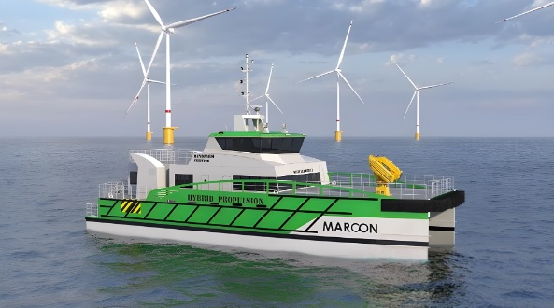
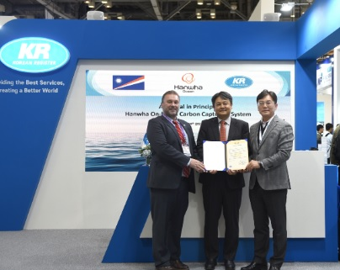
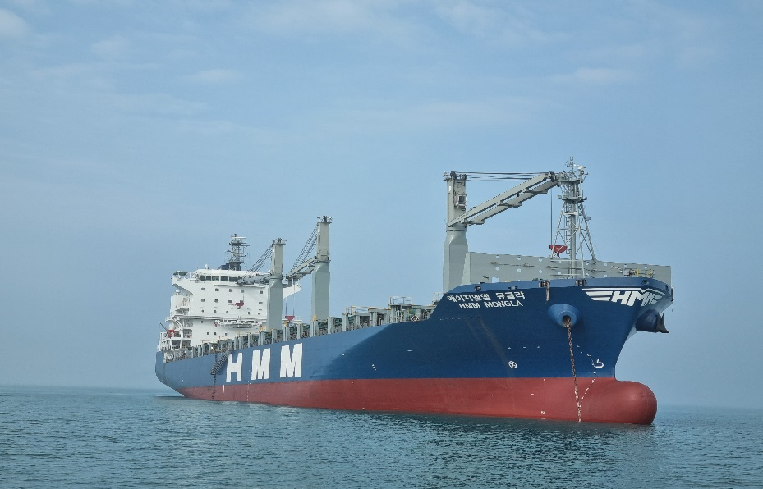
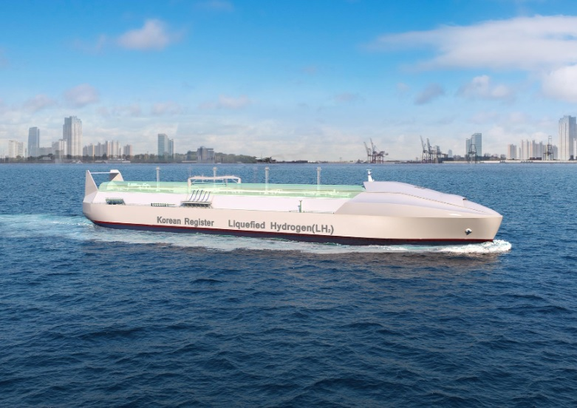
De-carbonization
AIP for Electric Propulsion Hybrid CTV
AIP for Onboard CO2 Capture System
Korea’s First OCCS installation
R&D for MW-class Hydrogen Engine for Ship
Notes:
OCCS
KR has announced the successful installation of an onboard carbon capture system (OCCS) with purely domestic technology, and it will soon undergo internal verification testing.
The project began in April 2023 as a collaborative effort with HMM, Samsung Heavy Industries (SHI), and PANASIA. As a result of this collaboration, the system was installed on the 2,200 teu container ship, HMM Mongla. KR conducted the risk assessment and application of relevant regulations in this OCCS project.
R&D for MW-class Hydrogen Engine for Ship with HD Hyundai
The core technology of this joint development project, a large-capacity direct injection hydrogen injector, is a critical component for ship internal combustion engines. Currently, there are no commercialized cases, but HD Korea Shipbuilding & Marine Engineering, which successfully developed Korea's first 1.5MW LNG-hydrogen dual-fuel engine, is expected to create synergy by collaborating with HD Hyundai Heavy Industries.
KR plans to participate in joint research on the development of hydrogen injection and supply devices for MW-class hydrogen internal combustion engines, as well as integrated land demonstrations linked to the HiMSEN engine*, alongside 16 institutions, including two companies from the HD Hyundai Group. As the leading research institution for one of the four detailed consortia in this project, KR.
Through this joint research, we expect to secure the foundational technology for hydrogen direct injection engines that use hydrogen as 100% fuel

Slide 35
Contents
1. General
2. Technical Expertise and Resources
3. Global Coverage and Support Network
4. Risk Management and Safety Standards
5. Value-Added Services
6. Digital Capabilities and Future-Readiness
7. Suggestions for Cooperation

Slide 36
Suggestions for Cooperation
Recent Export Projects Conducted by KR
Oil Tankers
1) Philippines / Via Marine, KYTS1020(DL in Aug. 2025), GT 3,360, OIL TANKER, KOREA YANASE
2) Thailand / V.L. Enterprise, MV V.L. 23(CN.2100023), GT 2,033, OIL TANKER, KHAN
Passenger Ships
1) Senegal, MV DIAMBOGNE(CN.1400039), GT 2,600, CAR FERRY, DONGIL SHIPYARD
2) Cape Verde, MV CHIQUINHO BL(CN.1900076), GT 1,316, CAR FERRY, MIRAE SHIPYARD
Others
1) Iraq, MV ALMUTHANNA(CN.1400079), GT 641, TUG BOAT, SAM KWANG SHIPBUILDING

Slide 37
Suggestions for Cooperation
Circumstances
New Chapter 5 of MARPOL Annex VI – Regulation on the IMO Net-Zero Framework
This chapter shall apply to all ships of 5,000 gross tonnage and above
Aged Oil Tankers less than 10K DWT
6,922 Ships amounting to 12.3mGT of av. 27.2 years old
Orderbook 1.4m GT(0.8m GT in 2025, 0.5m GT in 2026, 0.1m GT in 2027)
(Sources : World Fleet Register, Clarksons)
Fees on maritime transport services by USTR do not apply to the following Chinese-built vessels
With a capacity of equal to or less than: 4,000 Twenty-Foot Equivalent Units, 55,000 deadweight tons,
or an individual bulk capacity of 80,000 deadweight tons, Chemical tanker
(Sources : USTR, Billing Code 3390-F4)

Slide 38
Suggestions for Cooperation
Co-work for Export Projects
Promotion for Export Project by KR together with KOSIC
With KR’s network worldwide
List of shipyards with contact information, building capacities and track records in details to be shared
Co-work for R&D Project with KOSIC R&D Support Center
Approval-In-Principle Project as applicable
Korea-Built Premium Ship

Slide 39

The world is changing very fast.
Big will not beat small anymore.
It will be fast beating slow.
- Rupert Murdoch -

